Slide 1
GUI Calculator
A GUI-based calculator written in python.

Slide 2
What is a calculator?
It is something used for mathematical calculations, especially arithmetic operations.
Calculators come in the form of physical devices or as apps/programs in your gadgets.
I have developed a GUI-based calculator in Python using the Tkinter module.

Slide 3
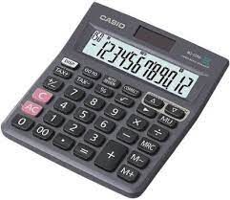
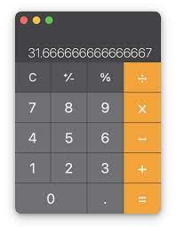
Pics

Slide 4
How I did it?
Using the Tkinter module, I have developed the GUI of the app with the buttons and the input field.
I learnt Tkinter before, but I did a quick recap of it.

Slide 5
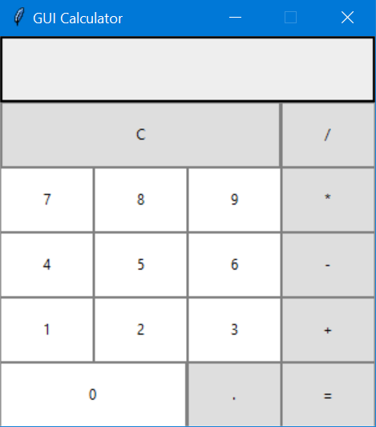
How to run it?
Firstly, make sure Python and Pip is installed in your computer.
Use `pip install tk` and Tkinter is installed.
Now, open the Python file and run it. You get the output similar to the image here.

Slide 6
Download
To download the code and the media, visit:
https://github.com/Anikethc/Python/tree/main/GUI%20-%20Calculator
Then, put the files in one directory and you can use it.

Slide 7
Thank you
By: Aniketh Chavare (11 A)

